Slide 1

Web scraping to gain company insights
BEDDA Hana
02/08/2023

Slide 2
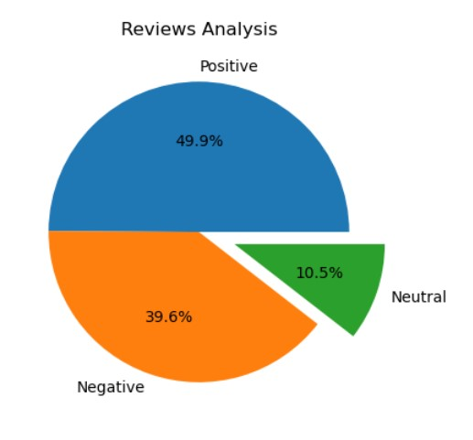
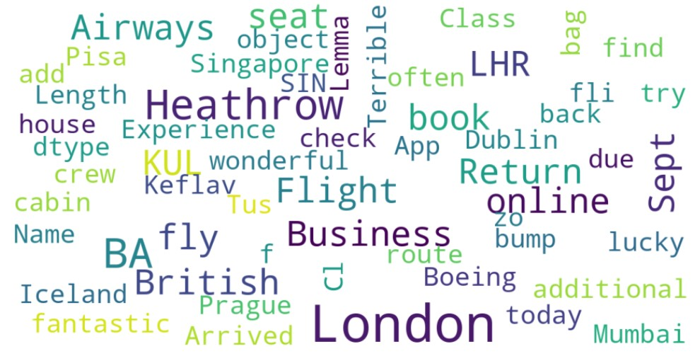
INSIGHTS FROM CUSTOMER REVIEWS
From cleaning 1000 reviews given by the customers, we obtained
Positive Reviews - 499
Negative Reviews - 396
Neutral Reviews – 105
Word cloud of keywords used in reviews

